Slide 1
Lecture 09: Interrupts & 8259

Slide 2
The 80x86 IBM PC and Compatible Computers
Chapter 14
Interrupts and the 8259 Chip

Slide 3
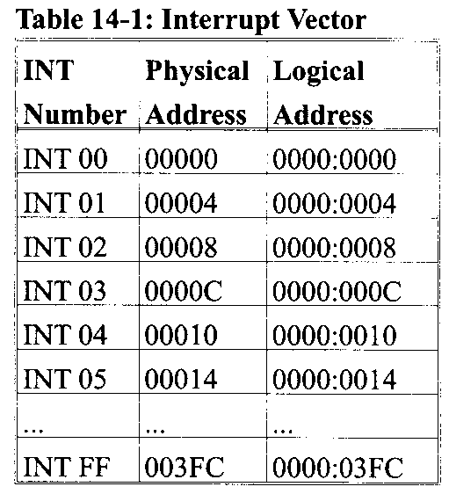
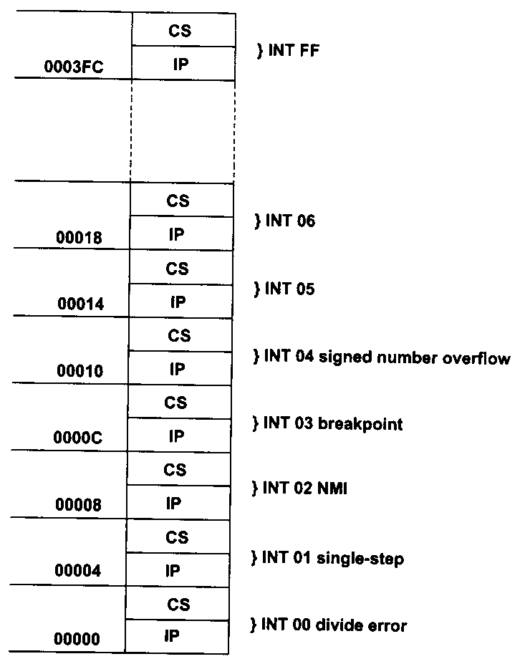
Interrupts in 8086/8088
256 interrupt types in total
  INT 00 ~ INT 0FFh
Type * 4 = PA of interrupt vector
  The first 1KB is used to store interrupt vectors, called Interrupt Vector Table (IVT)
Interrupt vector points the entrance address of the corresponding interrupt service routine (ISR)

Slide 4
Main Program and ISR
An ISR is launched by an interrupt event (internal ‘int xx’, external NMI and INTR) . So ISR is ‘separated’ from main.

Slide 5
Difference between INT & CALL
Since they all save CS:IP, so what’s different?
  CALL FAR can jump anywhere within 1MB vs. INT jumps to a fix location
  CALL FAR is in the sequence of instructions vs. an external interrupt can come in at any time
  CALL FAR cannot be masked (disabled) vs. an external interrupt can be masked
  CALL FAR saves CS:IP of next instruction vs. INT saves FR + CS:IP
  last instruction: RET vs. IRET

Slide 6
Categories of Interrupts
Hardware (external) interrupts
  Maskable
  Non-maskable
Software (internal) interrupts

Slide 7
Hardware Interrupts
Non-maskable interrupt
  NMI pin, input-signal, rising edge and two-cycle high activate
  INT 02
  Not affected by the IF
  Reasons:
    E.g., RAM parity check error, interrupt request from co-CPU 8087

Slide 8
Hardware Interrupts
Maskable interrupt
  INTR pin, input-signal, high active
  No predefined type INT nn
  IF = 1, enable; IF = 0, disable
    STI sets IF, CLI clears IF
  Reasons:
    Interrupt requests of external I/O devices

Slide 9
Software Interrupts
INT nn instruction
  An ISR is called upon instruction such as “INT nn”
    E.g., int 21h ; Dos service
“INT 00” (divide error)
  Reason: dividing a number by zero, or quotient is too large
“INT 01” (single step)
  If TF = 1, CPU will generates an INT 1 interrupt after executing each instruction for debugging

Slide 10
Software Interrupts
“INT 03” (breakpoint)
  When CPU hits the breakpoint set in the program, CPU generates INT 3 interrupt for debugging
“INT 04” (signed number overflow)
  INTO instruction
  Check the OF after an arithmetic instruction
    E.g.,
  MOV AX,0009H MOV AX,9000H
  ADD AX,0080H ADD AX,8000H
  INTO INTO
“INT 05” to “INT 0FFh” are open to either software or hardware

Slide 11
Procedure for Processing Maskable Interrupts
CPU responds to interrupt requests
  External I/O devices send interrupt requests to CPU
  CPU will check INTR pin on the last cycle of an instruction: if the INTR is high and IF = 1, CPU responds to the interrupt request
  CPU sends two ~INTA signals to the I/O device
  After receiving the second ~INTA, I/O device sends the interrupt type N on the data bus

Slide 12
Procedure for Processing Maskable Interrupts
CPU executes the ISR of INT N
  CPU reads the N from data bus
  Push the FR in stack
  Clear IF and TF
  Push the CS : IP of the next instruction in stack
  Load the ISR entrance address and moves to the ISR
  At the end of the ISR, IRET will pop IP, CS and FR in turn, CPU returns to previous program and proceeds

Slide 13
Procedure for Processing Non-Maskable & Software Interrupts
For NMI
  CPU checks NMI, generates INT 2 interrupt automatically regardless of IF and executes to the ISR
For software (internal) interrupts
  CPU generates INT N interrupt automatically and executes to the corresponding ISR

Slide 14
Interrupt Vector Table of 8086/8088
256 interrupts
❖ 0～4 dedicated
❖ 5～31reserved for system use
□ 08H～0FH：8259A
□ 10H～1FH：BIOS
❖ 32～255 reserved for users
□ 20H～3FH：DOS
□ 40H～FFH：open
For users,
224 interrupts
For system,
27 interrupts
5 dedicated interrupts

Slide 15
Priority of INTR Interrupts
Software polling
  The sequence of checking determines the priority

Slide 16
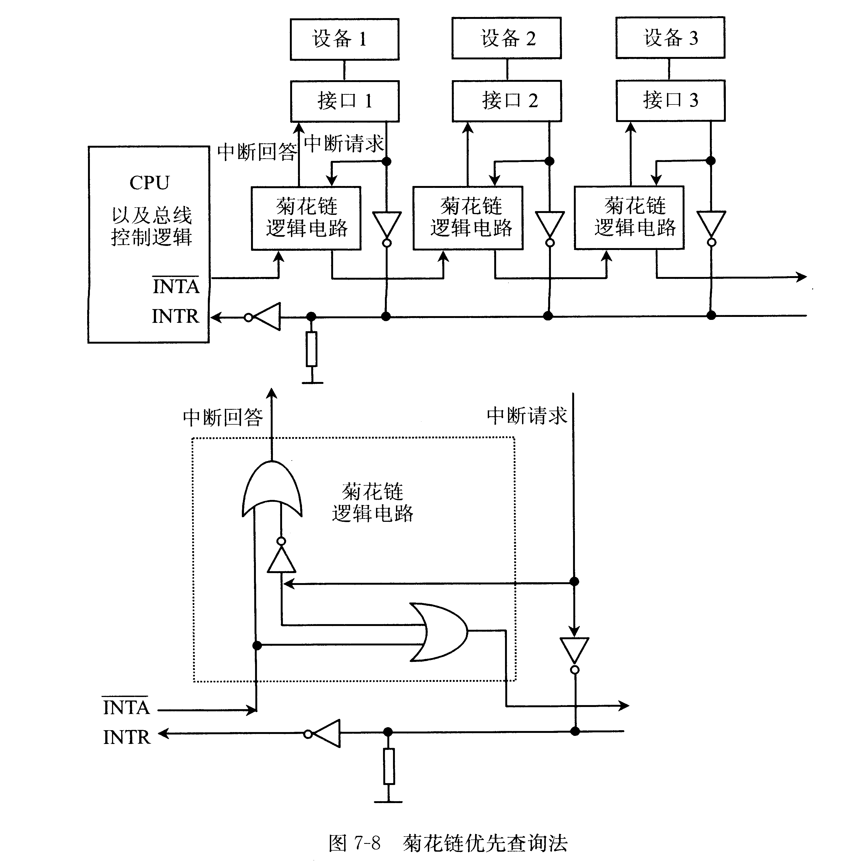
Priority of INTR Interrupts
Hardware checking
  The location in the daisy chain

Slide 17
Priority of INTR Interrupts
Vectored interrupt controller
  E.g., 8259

Slide 18
8259
8259 is Programmable Interrupt Controller (PIC)
It is a tool for managing the interrupt requests.
8259 is a very flexible peripheral controller chip:
  PIC can deal with up to 64 interrupt inputs
  interrupts can be masked
  various priority schemes can also programmed.
originally (in PC XT) it is available as a separate IC
Later the functionality of (two PICs) is in the motherboards chipset.
In some of the modern processors, the functionality of the PIC is built in.

Slide 19
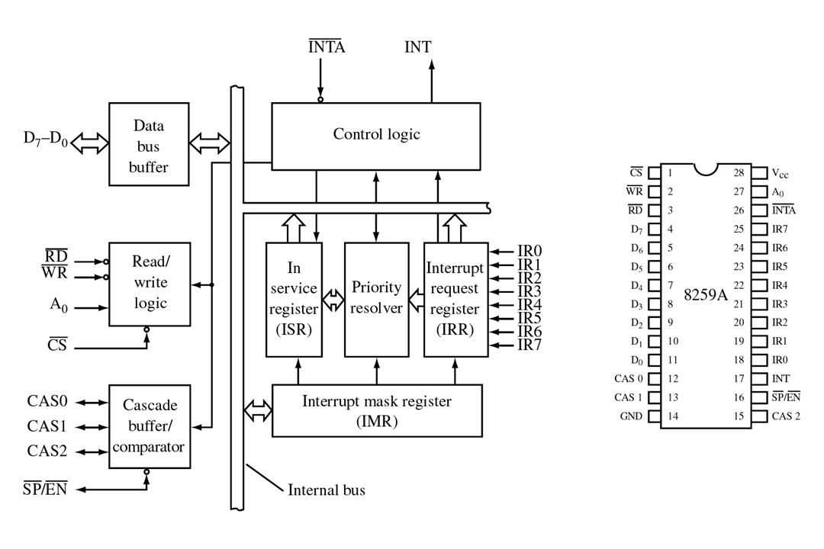
FIGURE 1 Block diagram and pin definitions for the 8259A Programmable Interrupt Controller (PIC). (Courtesy of Intel Corporation.)

Slide 20
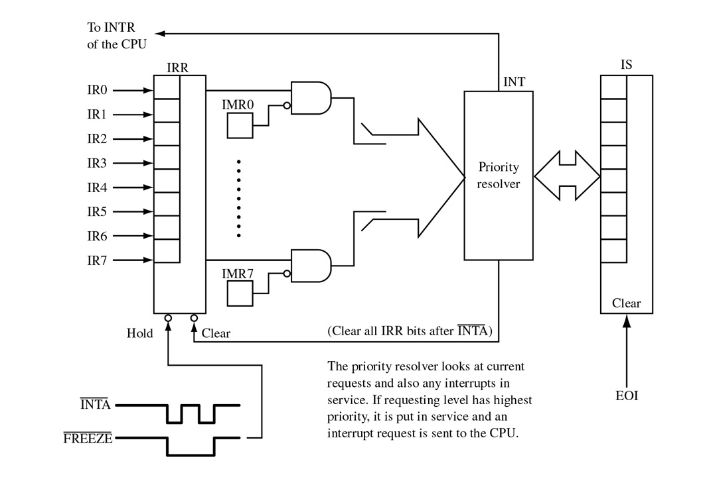
FIGURE 2 All interrupt requests must pass through the PIC’s interrupt request register (IRR) and interrupt mask register (IMR). If put in service, the appropriate bit of the in-service (IS) register is set.

Slide 21
Interrupt Nesting
Higher priority interrupts can interrupt lower interrupts
Main Program
IR2 and IR4 INTR
IR2 ISR
IR1 INTR
IR1 ISR
:
:
:
:
STI
:
(EOI)
:
IRET
STI
:
:
(EOI)
IRET
Set IF = 1
Allow lower priority interrupts
Allow lower priority interrupts in 8259
IR4 ISR
IR3 ISR
IR3 INTR
:
STI
:
:
(EOI)
IRET
:
STI
:
(EOI)
IRET
IF = 1
Allow lower priority interrupts
Allow lower priority interrupts

